Slide 1
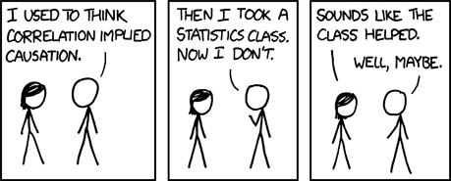
https://xkcd.com/552/

Slide 2
Critical Thinking
Class 2

Slide 3
Last week: Correlation and causation

Slide 4
Last week: Correlation and causation
Correlation: ?
Causation:

Slide 5
Last week: Correlation and causation
Correlation: X related to Y
Causation: ?

Slide 6
Last week: Correlation and causation
Correlation: X related to Y
Causation: X leads to Y

Slide 7

Last week: Correlation and causation

Slide 8
Last week: Correlation and causation
Correlation or causation?

Slide 9
Last week: Correlation and causation
Correlation!

Slide 10
Last week: Correlation and causation
Correlation:
Different rate of anxiety for remote than in-office workers

Slide 11
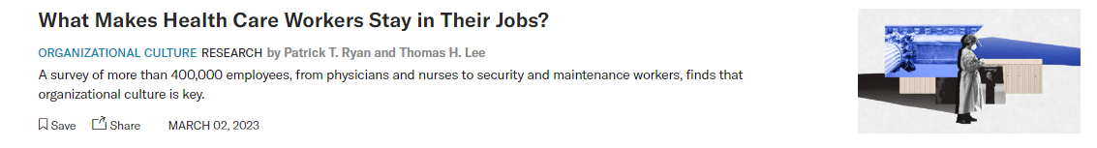
Last week: Correlation and causation

Slide 12
Last week: Correlation and causation
Correlation or causation?

Slide 13
Last week: Correlation and causation
Causal claim:

Slide 14
Last week: Correlation and causation
Causal claim:
organizational culture -> retainment

Slide 15
Last week: Correlation and causation
Correlation: X related to Y
Causation: X leads to Y

Slide 16
Last week: Evaluating a claimed correlation

Slide 17
Last week: Evaluating a claimed correlation
What makes a claimed correlation convincing?

Slide 18
Last week: Evaluating a claimed correlation
A convincing claim of correlation requires data:

Slide 19
Last week: Evaluating a claimed correlation
A convincing claim of correlation requires data:
Rate is (significantly) different between the group

Slide 20
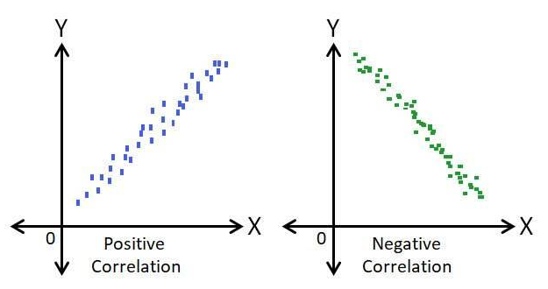
Last week: Evaluating a claimed correlation
A convincing claim of correlation requires data:
Rate is (significantly) different between the group
OR

Slide 21

Why correlation $≠$ causation
“remote workers are more anxious about layoffs”

Slide 22
Why correlation $≠$ causation
“remote workers are more anxious about layoffs”
Does remote work (X) cause layoff anxiety (Y)?
X -> Y

Slide 23
Why correlation $≠$ causation
“remote workers are more anxious about layoffs”
Does remote work (X) cause layoff anxiety (Y)?
X -> Y
Perhaps layoff anxiety leads to remote work?
Y->X

Slide 24
Confounding variable
Perhaps a third variable, a confounding variable, causes both?
C
X
Y

Slide 25
Confounding variable
Perhaps a third variable, a confounding variable, causes both?
E.g., organizational culture
C
X
Y

Slide 26
Summary
Correlation causation

Slide 27
Summary
Correlation causation
Causation correlation
?

Slide 28

Summary
Correlation causation
Causation correlation

Slide 29
Summary
Correlation causation
Causation correlation
With rare exceptions

Slide 30
Is knowing correlations useful?

Slide 31
Is knowing correlations useful?
Prediction

Slide 32
Is knowing correlations useful?
Prediction
Examples?

Slide 33
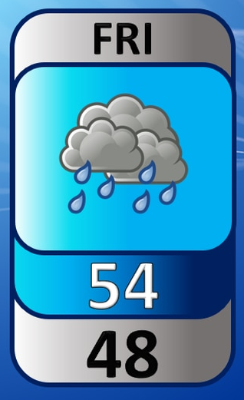

Is knowing correlations useful?
Prediction
Examples?

Slide 34
Is knowing correlations useful?
Prediction
What else?

Slide 35
Is knowing correlations useful?
Prediction
Identifying potential causal links

Slide 36
What do we need causation for?

Slide 37
What do we need causation for?
Manipulation – creating a change

Slide 38
Establishing causality
How?

Slide 39
Establishing causality
Find the direction of influence

Slide 40
Establishing causality
Find the direction of influence
How?

Slide 41
Establishing causality
Find the direction of influence
Temporal order (which came first?)

Slide 42
Establishing causality
Find the direction of influence
Temporal order (which came first?)
“Logic”

Slide 43
Establishing causality
Find the direction of influence
Temporal order (which came first?)
“Logic” (forecasts cannot influence the weather)

Slide 44
Establishing causality
Find the direction of influence
Ruling out confounds

Slide 45
Establishing causality
Find the direction of influence
Ruling out confounds
C
X
Y

Slide 46
Establishing causality
Find the direction of influence
Ruling out confounds
C
X
Y

Slide 47
Example cases
“a study examining historical data over 50 years found that Olympic runners live longer lives compared other Olympic athletes”

Slide 48
Example cases
“a study examining historical data over 50 years found that Olympic runners live longer lives compared other Olympic athletes”
Enough to establish correlation?

Slide 49
Example cases
“a study examining historical data over 50 years found that Olympic runners live longer lives compared other Olympic athletes”
Enough to establish correlation?
Yes – different athlete groups have different life expectancies

Slide 50
Example cases
“a study examining historical data over 50 years found that Olympic runners live longer lives compared other Olympic athletes”
Enough to establish causation (running is healthier than other sports at the Olympic level)?

Slide 51
Example cases
“a study examining historical data over 50 years found that Olympic runners live longer lives compared other Olympic athletes”
Enough to establish causation (running is healthier than other sports at the Olympic level)?
No.

Slide 52
Example cases
“a study examining historical data over 50 years found that Olympic runners live longer lives compared other Olympic athletes”
Enough to establish causation (running is healthier than other sports at the Olympic level)?
What would you need to do to establish a causal link between running and living longer?

Slide 53
Example cases
“A large study found that children who watch TV for more than 2 hours each day have lower reading scores”

Slide 54
Example cases
“A large study found that children who watch TV for more than 2 hours each day have lower reading scores”
Enough to establish correlation?

Slide 55
Example cases
“A large study found that children who watch TV for more than 2 hours each day have lower reading scores”
Enough to establish causation (TV watching is bad for reading)?

Slide 56
Example cases
“A large study found that children who watch TV for more than 2 hours each day have lower reading scores”
Enough to establish causation (TV watching is bad for reading)?
What would you need to do to establish a causal link between watching TV and reading ability?

Slide 57
Controlled experiments

Slide 58
Controlled experiments
The gold standard for establishing causality

Slide 59
Controlled experiments
Two (or more) equal groups

Slide 60
Controlled experiments
Two (or more) equal groups
Manipulation group(s) and control group

Slide 61
Controlled experiments
Two (or more) equal groups
Manipulation group(s) and control group
Manipulation

Slide 62
Controlled experiments
Two (or more) equal groups
Manipulation group(s) and control group
Manipulation
Statistical test for difference between groups

Slide 63
Controlled experiments - logic

Slide 64
Controlled experiments - logic
Groups are equal before the manipulation and different after the manipulation

Slide 65
Controlled experiments - logic
Groups are equal before the manipulation and different after the manipulation
The cause for the difference between the groups is the manipulation

Slide 66
Controlled experiments - complications
Creating equal groups

Slide 67
Controlled experiments - complications
Creating equal groups
Experimental validity – manipulating only the intended constructs

Slide 68
Creating equal groups
Matched controls – assigning people to the control and manipulation group in matched pairs based on:
Age
Gender
Income
Education
…

Slide 69
Creating equal groups
Matched controls – assigning people to the control and manipulation group in matched pairs based on:
Age
Gender
Income
Education
…
Hard to do with more matched variables

Slide 70
Creating equal groups
Matched controls – assigning people to the control and manipulation group in matched pairs based on:
Age
Gender
Income
Education
…
Hard to do with more matched variables
What about unmatched variables?

Slide 71
Creating equal groups
Random assignment – assign people to control or manipulation group randomly

Slide 72
Creating equal groups
Random assignment – assign people to control or manipulation group randomly
Groups should be equal due to the law of large numbers

Slide 73
Creating equal groups
Random assignment – assign people to control or manipulation group randomly
Groups should be equal due to the law of large numbers
But..
Larger samples needed

Slide 74
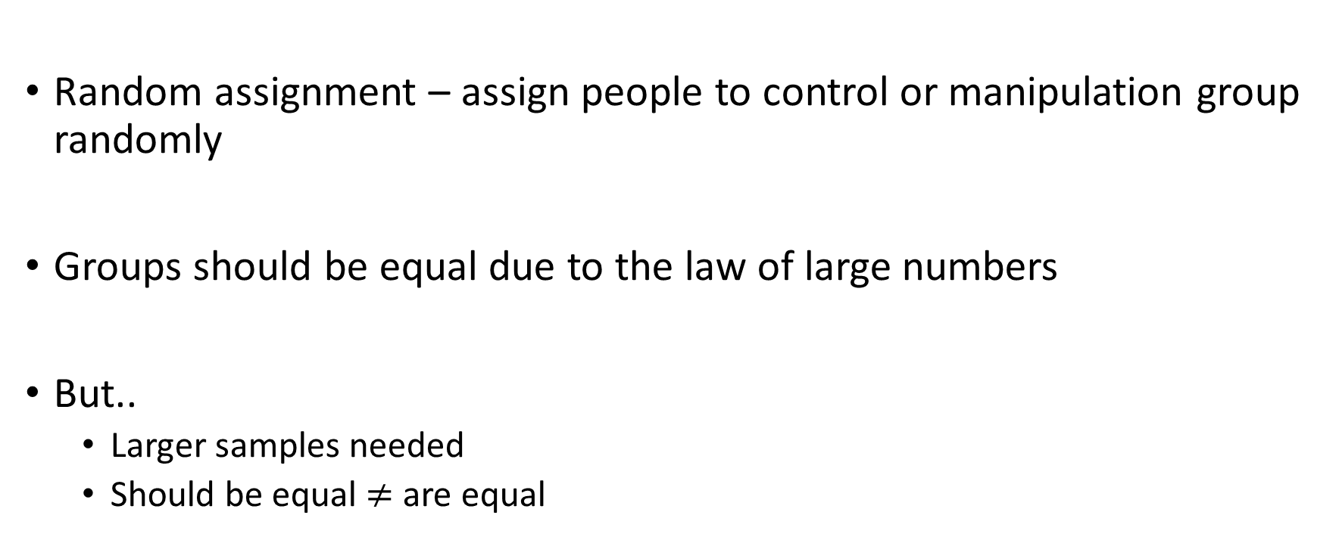
Creating equal groups
Random assignment – assign people to control or manipulation group randomly
Groups should be equal due to the law of large numbers
But..
Larger samples needed
Should be equal $≠$ are equal

Slide 75
Creating equal groups
Interpretation of results depends on the assumption that groups are equal before the manipulation!

Slide 76
Creating equal groups
Interpretation of results depends on the assumption that groups are equal before the manipulation!
Can be tested, but never exhaustively

Slide 77
Are experiments common in business?

Slide 78
A/B testing

Slide 79
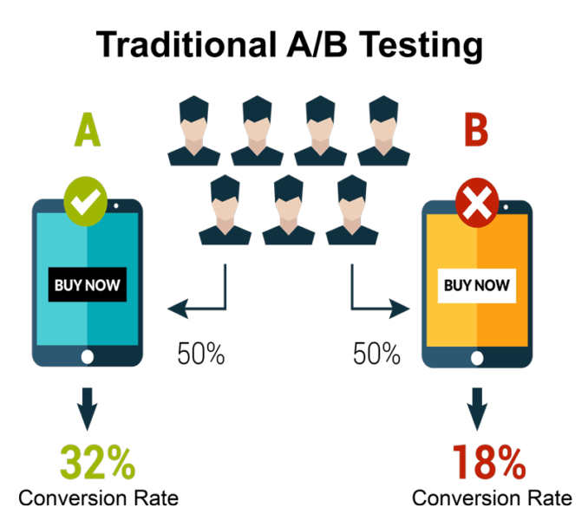
A/B testing

Slide 80
Experimental validity

Slide 81
Experimental validity
Example experiment:
2,000 participants with headache

Slide 82
Experimental validity
Example experiment:
2,000 participants with headache
Random assignment
1,000 control group (do nothing)
1,000 take Paracetamol (אקמול)

Slide 83
Experimental validity
Example experiment:
2,000 participants with headache
Random assignment
1,000 control group (do nothing)
1,000 take Paracetamol (אקמול)
After 1 hour, ask about current pain level

Slide 84
Experimental validity
Example experiment:
2,000 participants with headache
Random assignment
1,000 control group (do nothing)
1,000 take Paracetamol (אקמול)
After 1 hour, ask about current pain level
Result: Pain significantly lower in paracetamol group

Slide 85
Experimental validity
Example experiment:
2,000 participants with headache
Random assignment
1,000 control group (do nothing)
1,000 take Paracetamol (אקמול)
After 1 hour, ask about current pain level
Result: Pain significantly lower in paracetamol group
Does paracetamol decrease pain?

Slide 86
Experimental validity
Example experiment:
2,000 participants with headache
Random assignment
1,000 control group (do nothing)
1,000 take Paracetamol (אקמול)
After 1 hour, ask about current pain level
Result: Pain significantly lower in paracetamol group
Does paracetamol decrease pain?
Is there an alternative explanation for the result?

Slide 87
Expectation effects

Slide 88
Expectation effects
Participant expectations

Slide 89
Placebo

Slide 90
Placebo
Latin for “shall be pleasing”

Slide 91
Placebo
Latin for “shall be pleasing”
Placebo effect: when we expect something to help, it does

Slide 92
Placebo
Latin for “shall be pleasing”
Placebo effect: when we expect something to help, it does
Real effectiveness: placebo effects were the leading cause of medical treatment success until the late 18th century

Slide 93
Nocebo

Slide 94
Nocebo
When we expect something to have negative effects, it does

Slide 95

Nocebo
When we expect something to have negative effects, it does
E.g., expected medication side effects

Slide 96
Hawthorne effect
Series of studies conducted at Hawthorne Works plant, Illinois, between 1924 and 1927

Slide 97
Hawthorne effect
Series of studies conducted at Hawthorne Works plant, Illinois, between 1924 and 1927
Tested influence of working conditions on productivity

Slide 98
Hawthorne effect
Series of studies conducted at Hawthorne Works plant, Illinois, between 1924 and 1927
Tested influence of working conditions on productivity
Changes to:
Room lighting (increase / decrease / return to baseline)
Break length (increase / decrease / return to baseline)

Slide 99
Hawthorne effect
Series of studies conducted at Hawthorne Works plant, Illinois, between 1924 and 1927
Tested influence of working conditions on productivity
What were the optimal conditions?

Slide 100
Hawthorne effect
Series of studies conducted at Hawthorne Works plant, Illinois, between 1924 and 1927
Tested influence of working conditions on productivity
Every change led to increased productivity initially!

Slide 101
Hawthorne effect
Series of studies conducted at Hawthorne Works plant, Illinois, between 1924 and 1927
Tested influence of working conditions on productivity
Every change led to increased productivity initially!
Why?

Slide 102
Hawthorne effect
Being part of the manipulation group:
Feeling special
Closer oversight
…

Slide 103
Participant expectations
Participant knows they are in manipulation group

Slide 104
Participant expectations
Participant knows they are in manipulation group
Participant expects effect

Slide 105
Participant expectations
Participant knows they are in manipulation group
Participant expects effect
The manipulation appears to have an effect

Slide 106
Expectation effects
Participant expectations

Slide 107
Expectation effects
Participant expectations
Experimenter expectations

Slide 108
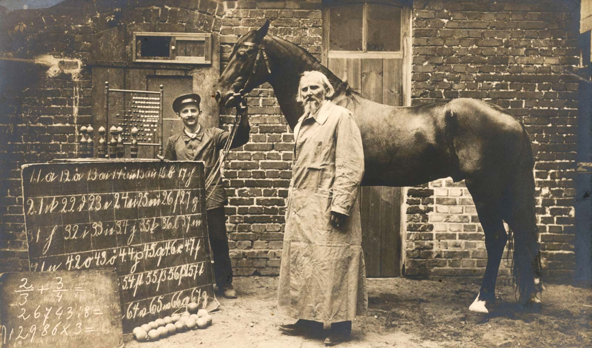
Clever Hans

Slide 109
Clever Hans
Clever Hans (a horse) could answer math questions by tapping the number with his foot

Slide 110
Clever Hans
Clever Hans (a horse) could answer math questions by tapping the number with his foot
How?

Slide 111
Clever Hans
Clever Hans (a horse) could answer math questions by tapping the number with his foot
The person asking knew the answer

Slide 112
Clever Hans
Clever Hans (a horse) could answer math questions by tapping the number with his foot
The person asking knew the answer
Hans responded to subtle body language

Slide 113
Pygmalion effect

Slide 114
Pygmalion effect
Teachers told some (randomly selected) children scored high on a “potential for learning” test

Slide 115
Pygmalion effect
Teachers told some (randomly selected) children scored high on a “potential for learning” test
Those children in fact scored higher by the end of the year

Slide 116
Pygmalion effect
Teachers told some (randomly selected) children scored high on a “potential for learning” test
Those children in fact scored higher by the end of the year
Higher expectations lead to better results

Slide 117
Experimenter expectations
experimenter knows expected results

Slide 118
Experimenter expectations
experimenter knows expected results
(subtle) differences in participant treatment
And / or
(subtle) differences in interpretation of ambiguous results

Slide 119
Experimenter expectations
experimenter knows expected results
(subtle) differences in participant treatment
And / or
(subtle) differences in interpretation of ambiguous results
The manipulation appears to have an effect

Slide 120
“Blinding”
To eliminate possible expectation effects:

Slide 121
“Blinding”
To eliminate possible expectation effects:
“Blind” participants – participants do not know which group they are in

Slide 122
“Blinding”
To eliminate possible expectation effects:
“Blind” participants – participants do not know which group they are in
How?

Slide 123
“Blinding”
To eliminate possible expectation effects:
“Blind” participants – participants do not know which group they are in
Placebo / sham treatment
Inform participants of group only after the experiment is over

Slide 124
“Blinding”
To eliminate possible expectation effects:
“Blind” participants – participants do not know which group they are in
Placebo / sham treatment
Inform participants of group only after the experiment is over
“Blind” experimenter – experimenter does not know assigned group or expected results

Slide 125
“Blinding”
To eliminate possible expectation effects:
“Blind” participants – participants do not know which group they are in
Placebo / sham treatment
Inform participants of group only after the experiment is over
“Blind” experimenter – experimenter does not know assigned group or expected results
“Double blind” – both participants and experimenters are “blind”

Slide 126
Example experiment
“A study found that children who watch TV for more than 2 hours each day have lower reading scores”

Slide 127
Example experiment
“A study found that children who watch TV for more than 2 hours each day have lower reading scores”
How would we test with an experiment?

Slide 128
Quasi experiments
In many cases, we cannot manipulate constructs we care about

Slide 129
Quasi experiments
In many cases, we cannot manipulate constructs we care about
Examples?

Slide 130
Quasi experiments
In many cases, we cannot manipulate constructs we care about
Examples:
Medical conditions (e.g., cancer, depression)
Economic status
Education level
Gender
…

Slide 131
Quasi experiments
Quasi experiment: an experiment where group assignment is not done by the researcher

Slide 132
Quasi experiments
Quasi experiment: an experiment where group assignment is not done by the researcher
Also known as observational study

Slide 133
Quasi experiments
Quasi experiment: an experiment where group assignment is not done by the researcher
E.g., comparing depressed patients to healthy participants on walking speed

Slide 134
Quasi experiments
Quasi experiment: an experiment where group assignment is not done by the researcher
Can still support, but not fully establish, causality

Slide 135
Quasi experiments
Quasi experiment: an experiment where group assignment is not done by the researcher
Can still support, but not fully establish, causality
Establish temporal order

Slide 136
Quasi experiments
Quasi experiment: an experiment where group assignment is not done by the researcher
Can still support, but not fully establish, causality
Establish temporal order
Rule out possible confounds

Slide 137
Quasi experiments
Quasi experiment: an experiment where group assignment is not done by the researcher
Can still support, but not fully establish, causality
Establish temporal order
Rule out possible confounds test possible confounds and show absence of correlation

Slide 138
Example
Is Alzheimer’s prevalence influenced by gender?

Slide 139
Example
Is Alzheimer’s prevalence influenced by gender?
Correlation – Alzheimer's is more common in women

Slide 140
Example
Is Alzheimer’s prevalence influenced by gender?
Correlation – Alzheimer's is more common in women
Temporal order – gender is determined well before Alzhimer’s onset

Slide 141
Example
Is Alzheimer’s prevalence influenced by gender?
Correlation – Alzheimer's is more common in women
Temporal order – gender is determined well before Alzhimer’s onset
Testing confounds – when comparing same aged people, Alzheimer's is not more common in women

Slide 142
Selection bias
When groups are not assigned by the experimenter, differences might be due to selection bias

Slide 143
Selection bias
“A teacher offers students an extra revision session before the test. Students who come to the extra session do better on the test.”

Slide 144
Selection bias
“A teacher offers students an extra revision session before the test. Students who come to the extra session do better on the test.”
Does the extra session improve students’ test scores?

Slide 145
Selection bias
“A teacher offers students an extra revision session before the test. Students who come to the extra session do better on the test.”
Which students come to the extra session?

Slide 146
Self selection

Slide 147
Self selection
When participants determine which group they are in, group differences might arise due to selection, not manipulation.

Slide 148
Self selection
When participants determine which group they are in, group differences might arise due to selection, not manipulation.
Active selection (volunteering)

Slide 149
Self selection
When participants determine which group they are in, group differences might arise due to selection, not manipulation.
Active selection (volunteering)
Unintentional selection e.g., compliant and non-compliant participants

Slide 150
External selection

Slide 151
External selection
When group assignment is influenced by external factors, these factors may lead to differences between groups

Slide 152
External selection
When group assignment is influenced by external factors, these factors may lead to differences between groups
E.g., In test of ultrasound screening effectiveness, screened pregnancies had higher chance of low birth weight.

Slide 153
External selection
When group assignment is influenced by external factors, these factors may lead to differences between groups
E.g., In test of ultrasound screening effectiveness, screened pregnancies had higher chance of low birth weight.
Does ultrasound negatively impact pregnancy?

Slide 154
External selection
When group assignment is influenced by external factors, these factors may lead to differences between groups
E.g., In test of ultrasound screening effectiveness, screened pregnancies had higher chance of low birth weight.
When a medical screening procedure is new, who is referred to the new procedure?

Slide 155
Let’s plan an experiment

Slide 156
Let’s plan an experiment
A potential causal link

Slide 157
Let’s plan an experiment
A potential causal link
What is the manipulation?

Slide 158
Let’s plan an experiment
A potential causal link
What is the manipulation?
What is the appropriate control?

Slide 159
Let’s plan an experiment
A potential causal link
What is the manipulation?
What is the appropriate control?
Blinding?

Slide 160
Suppression

Slide 161
Suppression
In some cases, causal influences may not lead to apparent statistical correlations, or even show inverse correlations

Slide 162
Suppression
In some cases, causal influences may not lead to apparent statistical correlations, or even show inverse correlations
S
X
Y

Slide 163
Suppression
In some cases, causal influences may not lead to apparent statistical correlations, or even show inverse correlations
Example?
S
X
Y

Slide 164
Suppression
In some cases, causal influences may not lead to apparent statistical correlations, or even show inverse correlations
?
Initial fire intensity
Cost of fire damage

Slide 165
Suppression
In some cases, causal influences may not lead to apparent statistical correlations, or even show inverse correlations
Number of firemen
Initial fire intensity
Cost of fire damage

Slide 166
Suppression
In some cases, causal influences may not lead to apparent statistical correlations, or even show inverse correlations
S
S
X
Y
X
Y
S
S
X
Y
X
Y

Slide 167
Suppression
In some cases, a positive causal influence may even appear as a negative correlation

Slide 168
Suppression
“Integrative schools teach special education and normal students in joint classes while mainstream schools teach them in separate classes. At the end of the year, all students from integrative and mainstream schools took a qualifying test. 57% of integrative school students passed, while 60% of mainstream school students passed”

Slide 169
Suppression
“Integrative schools teach special education and normal students in joint classes while mainstream schools teach them in separate classes. At the end of the year, all students from integrative and mainstream schools took a qualifying test. 57% of integrative school students passed, while 60% of mainstream school students passed”
Do integrative schools have worse outcomes?

Slide 170
Suppression
Mainstream schools:
Special education students: 200 students, 20% pass rate
Normal students: 800 students, 70% pass rate

Slide 171
Suppression
Mainstream schools:
Special education students: 200 students, 20% pass rate
Normal students: 800 students, 70% pass rate
Integrative schools:
Special education students: 400 students, 30% pass rate
Normal students: 600 students, 75% pass rate

Slide 172
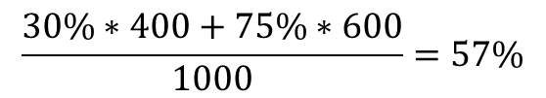
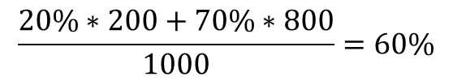
Suppression
Mainstream schools:
Special education students: 200 students, 20% pass rate
Normal students: 800 students, 70% pass rate
Integrative schools:
Special education students: 400 students, 30% pass rate
Normal students: 600 students, 75% pass rate
$$\frac{20\%∗200+70\%∗800}{1000}=60\%$$
$$\frac{30\%∗400+75\%∗600}{1000}=57\%$$

Slide 173
Suppression
Number of special education students
Integrative school
Overall pass rate

Slide 174
Summing up

Slide 175
Summing up
To establish causation
Correlation (usually)
Temporal order
Ruling out all possible confounds

Slide 176
Summing up
To establish causation
Correlation (usually)
Temporal order
Ruling out all possible confounds
Controlled (matched or random assignment), double blind experiment – the gold standard

Slide 177
Summing up
To establish causation
Correlation (usually)
Temporal order
Ruling out all possible confounds
Controlled (matched or random assignment), double blind experiment – the gold standard
Quasi experiments: not perfect, but better than nothing
Need to actively rule out confounds
Beware selection biases

Slide 178
Next week
The law of large numbers
Sampling, surveys and sampling biases

Slide 179
Additional example questions
An observational study found that women who regularly do yoga have a lower chance of miscarriage. Can we conclude that doing yoga lowers the chance of miscarriages?

Slide 180
Additional example questions
In the US, the death rate (number of deaths per 100,000 living in the area) in cities is higher than in rural areas. Can we conclude that city living is unhealthy?

Slide 181
Additional example questions
During the great depression unemployment in the US was extremely high. However, more educated people had a lower rate unemployment. Can we conclude that education protected workers from unemployment at the time?

Slide 182
Additional example questions
In the national math graduation exam, students have a choice between answering a question on matrix algebra or functional analysis. Functional analysis is known to be the harder subject, and only a small portion of students pick this topic. Despite this, success rate on the two topics is nearly identical. How could we explain this finding?

Slide 183
Additional example questions
A survey found a possible influence of pet ownership during childhood and career success. Of the 74 CEOs surveyed, 94% owned a dog, cat or both as children. The surveyed CEOs claimed that owning a pet as children helped them develop good character, which contributed to their successful careers. Evaluate this claim.

